Slide 1



Slide 2
TEAM MEMBERS
Mariam Ayman Helmy
mariiamayman96@gmail.com
Huda Mawood Kamal
hudamawood@gmail.com
Abir Refaey Hassan
abirrefai99@gmail.com

Slide 3
Introduction
This Global Health Data Analysis Project aims to uncover global mortality trends and identify regional patterns over time. By analyzing and visualizing data from various sources, the project seeks to provide insights that can inform public health decisions. Tools such as Python, Excel, and Power BI will be used to evaluate the dataset's structure, handle missing information, and generate meaningful insights. This foundational analysis will reveal mortality trends and enhance our understanding of global health statistics.
Purpose of the Analysis
To understand trends and patterns in causes of death over time.
To compare statistics between different countries.
To provide helpful insights and recommendation in making strategies regarding the public health.

Slide 4
CONTENTS
Python Analysis
Excel Workbook
Power BI Dashboard
Final Recommendations

Slide 5

PYTHON ANALYSIS

Slide 6
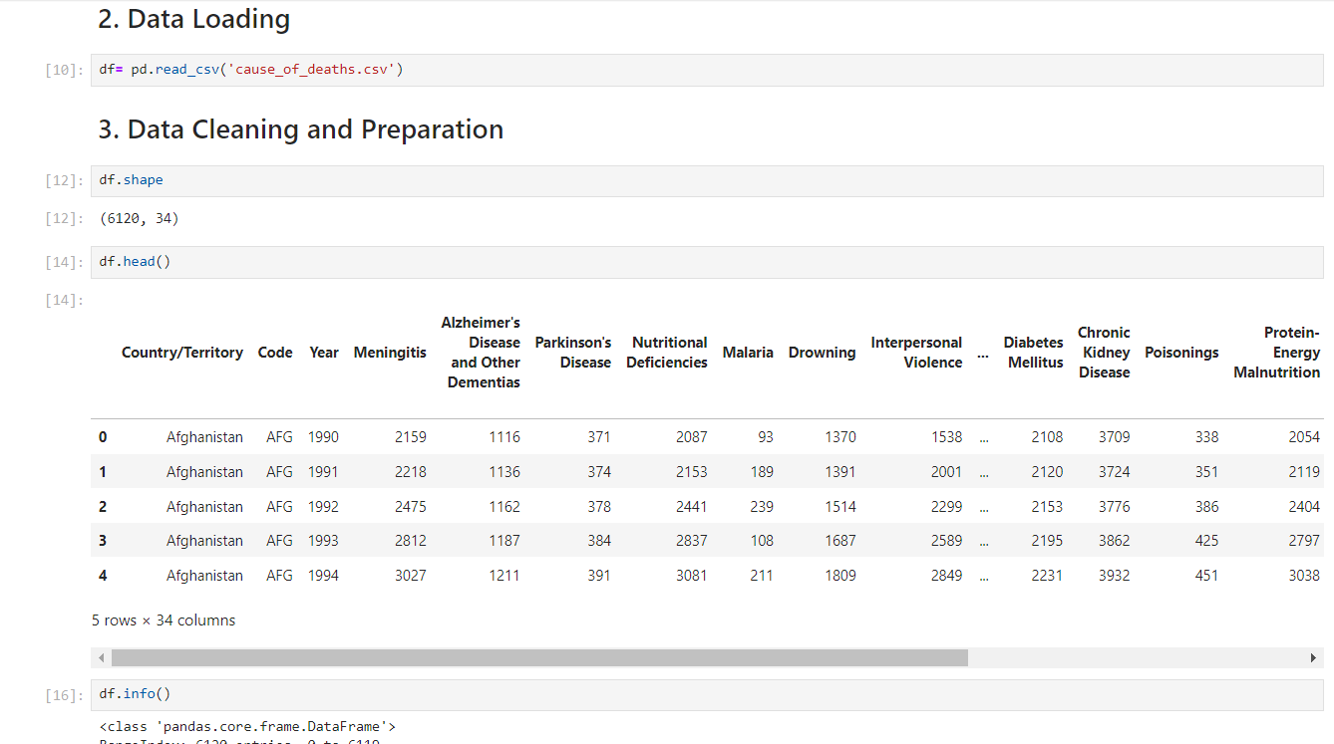
Data Overview
Dataset Description
Source: cause_of_deaths.csv
Key columns: Year, Country/Territory, Various Causes of Death
Initial Observations
Shape of the dataset
Data types and missing values

Slide 7
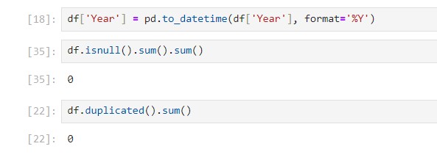
Data Cleaning
Steps Taken:
Converted 'Year' to datetime
Checked for null values and duplicates
Dropped unnecessary columns if any

Slide 8
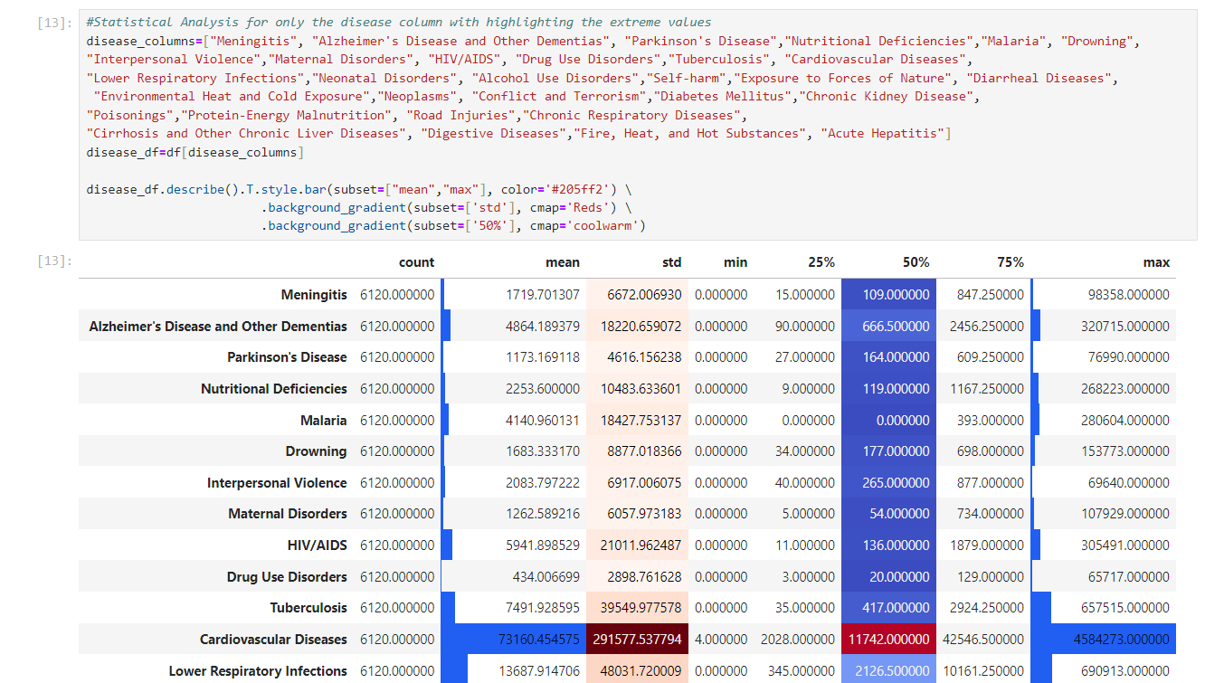
Descriptive Statistics of Causes of Death

Slide 9
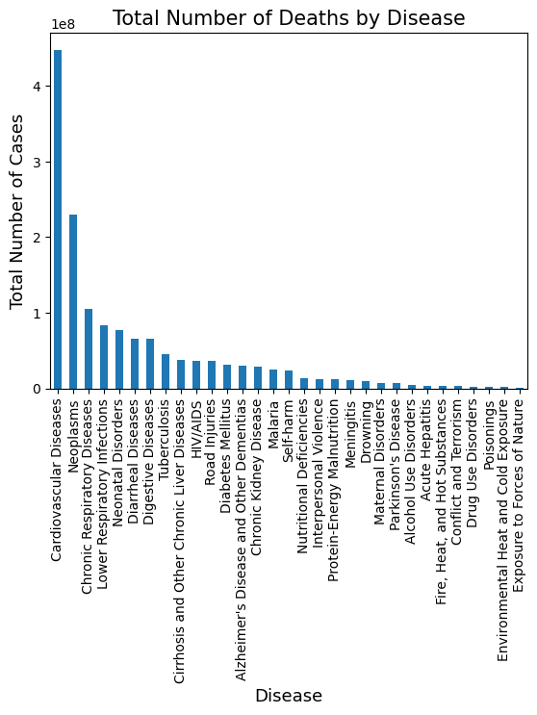
Visual Representations
- Bar chart showing total causes of death by each disease.

Slide 10
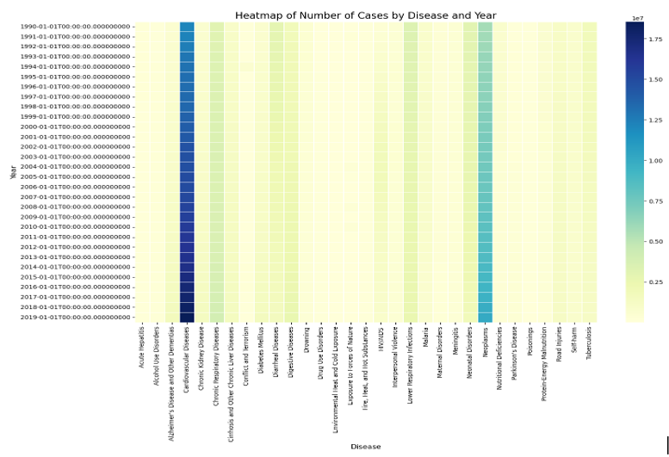
Visual Representations
- Heatmap summarizing patterns, correlations and trends over time in the causes of death data.

Slide 11
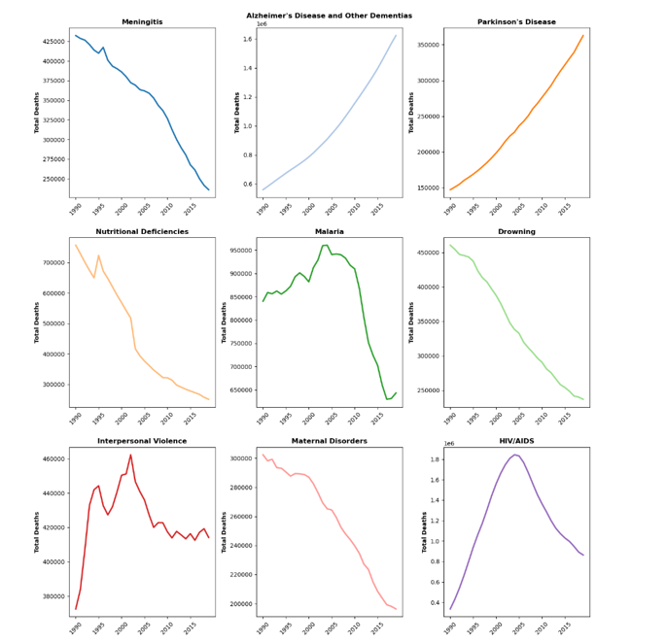
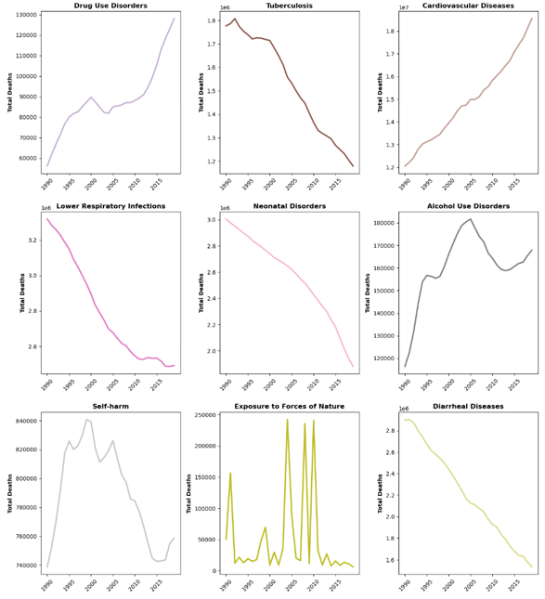
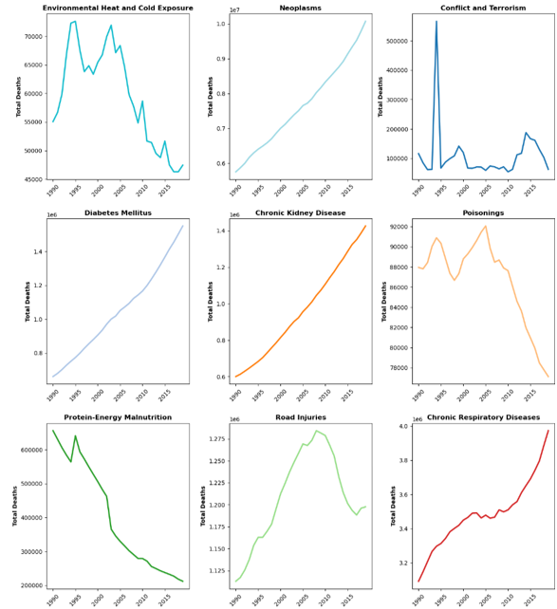
Trends Over Time
Subplots showing total cases by individual diseases over the years.

Slide 12
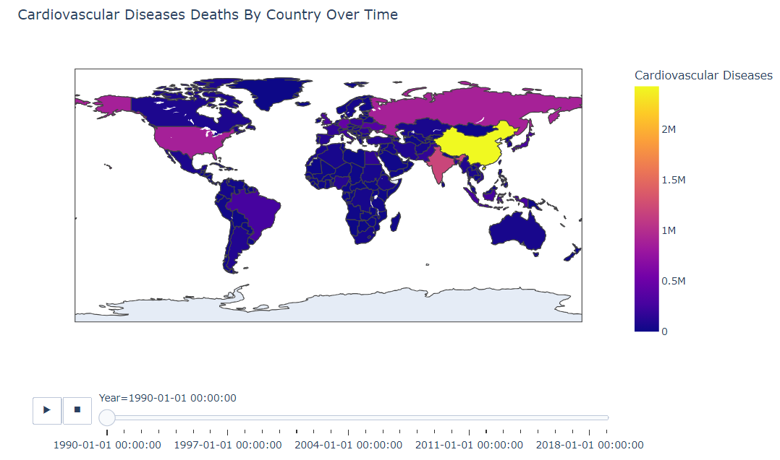
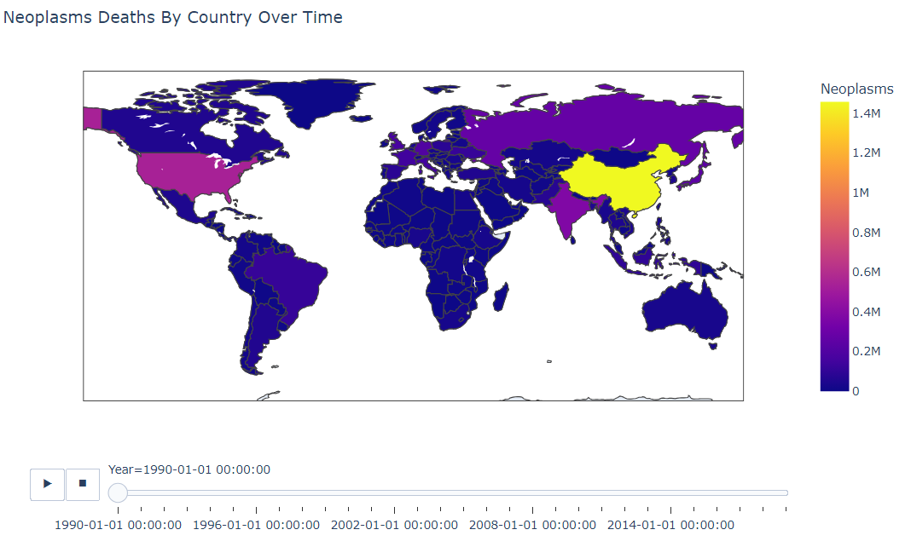
Geographic Distribution of Most Common Causes of Deaths
Choropleth Maps:
Cardiovascular Diseases, Neoplasms, Chronic Respiratory Diseases
Animation Over Time:
Show how deaths are distributed globally across the years.

Slide 13
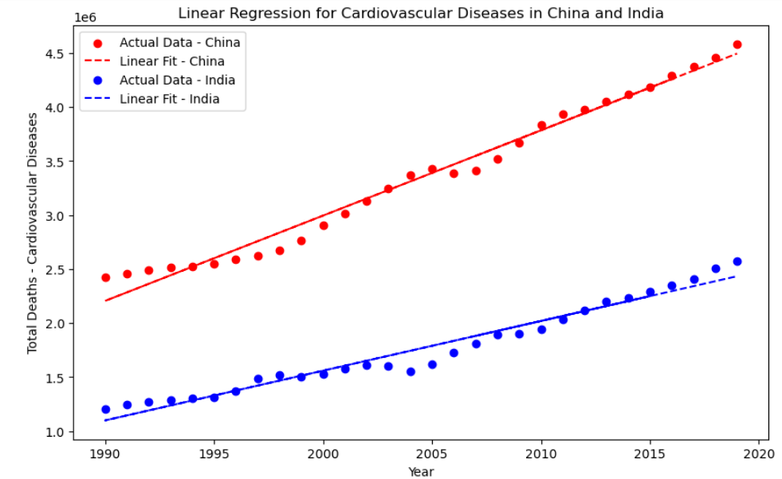
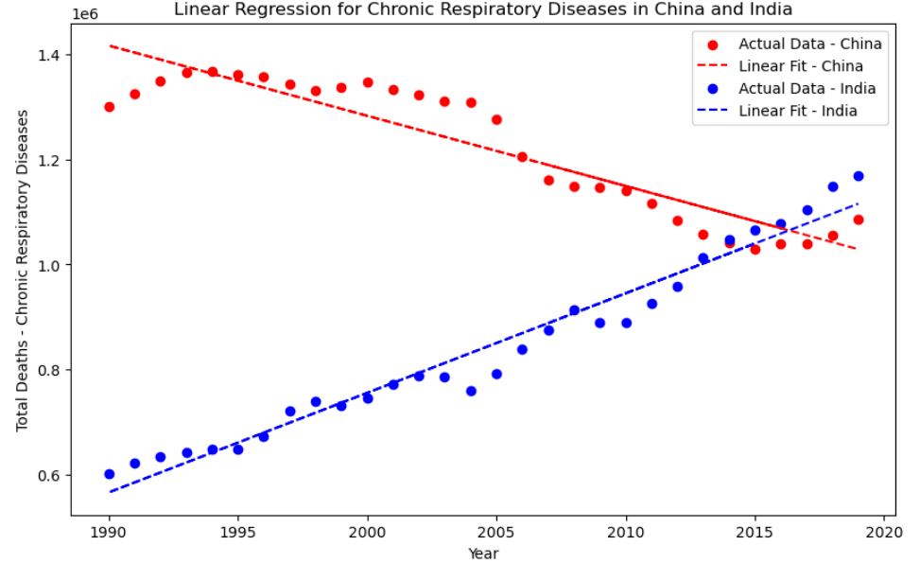
Predictive Analysis of Countries with Most Deaths
Linear Regression Models
Selected Diseases:
Cardiovascular Diseases, Neoplasms, Chronic Respiratory Diseases
Selected Countries:
China, India

Slide 14

EXCEL Workbook

Slide 15
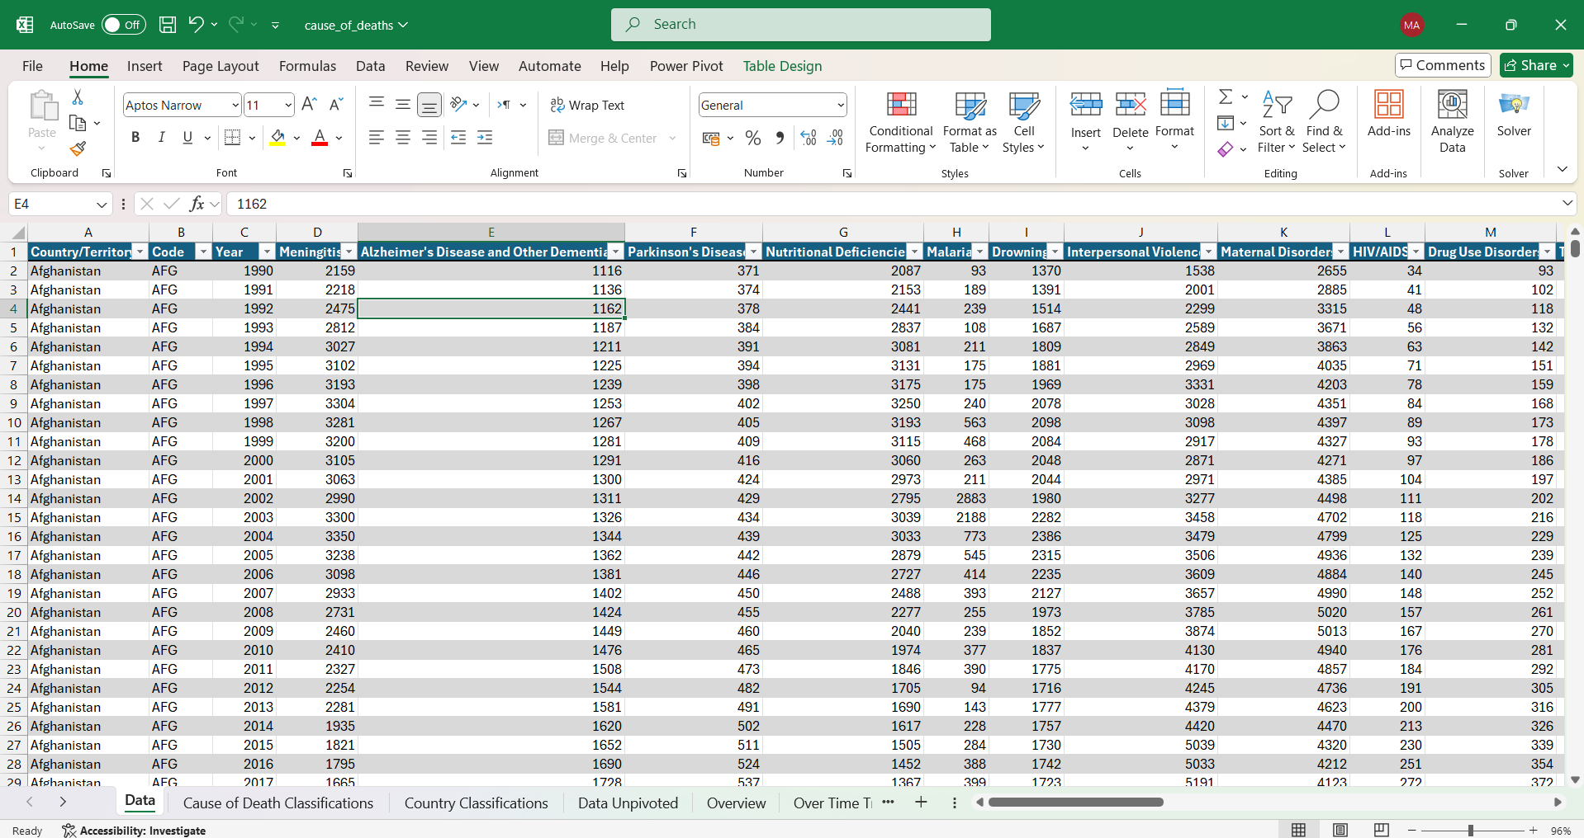
DATA OUTLINE
6121 rows
34 columns
- Country
- Country Code - Year - 31 different causes of death & diseases
No duplicates or missing values found

Slide 16
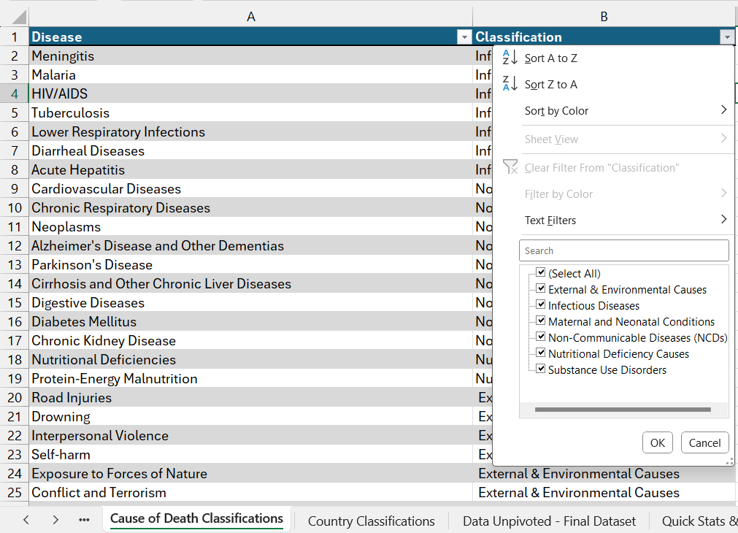
ADDED CLASSIFICATIONS
In order to make the analysis process more meaningful and insightful, official disease and country classifications were added to the dataset.
WHO disease classification helps categorize diseases based on their causes and impacts, guiding public health strategies and interventions:
Infectious Diseases: Caused by pathogens, spread through infection.
Non-Communicable Diseases (NCDs): Chronic diseases not caused by infections, often linked to lifestyle factors.
Nutritional Deficiency Causes: Result from inadequate intake of essential nutrients.
External & Environmental Causes: Related to injuries or conditions caused by environmental or external factors.
Substance Use Disorders: Disorders due to misuse or dependency on substances.
Maternal and Neonatal Conditions: Health issues affecting mothers during pregnancy and newborns.

Slide 17
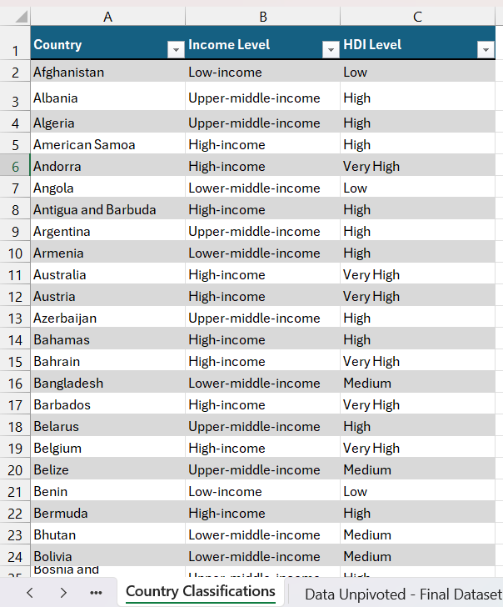
World Bank Income Level Classification:
Classifies countries into categories like Low-income, Lower-middle-income, Upper-middle-income, and High-income based on their Gross National Income (GNI).
UNDP HDI Level Classification:
Ranks countries based on the Human Development Index, which assesses overall human development and highlights the importance of improved healthcare systems to enhance life expectancy and quality of life. Levels include Low, Medium, High, and Very High.

Slide 18
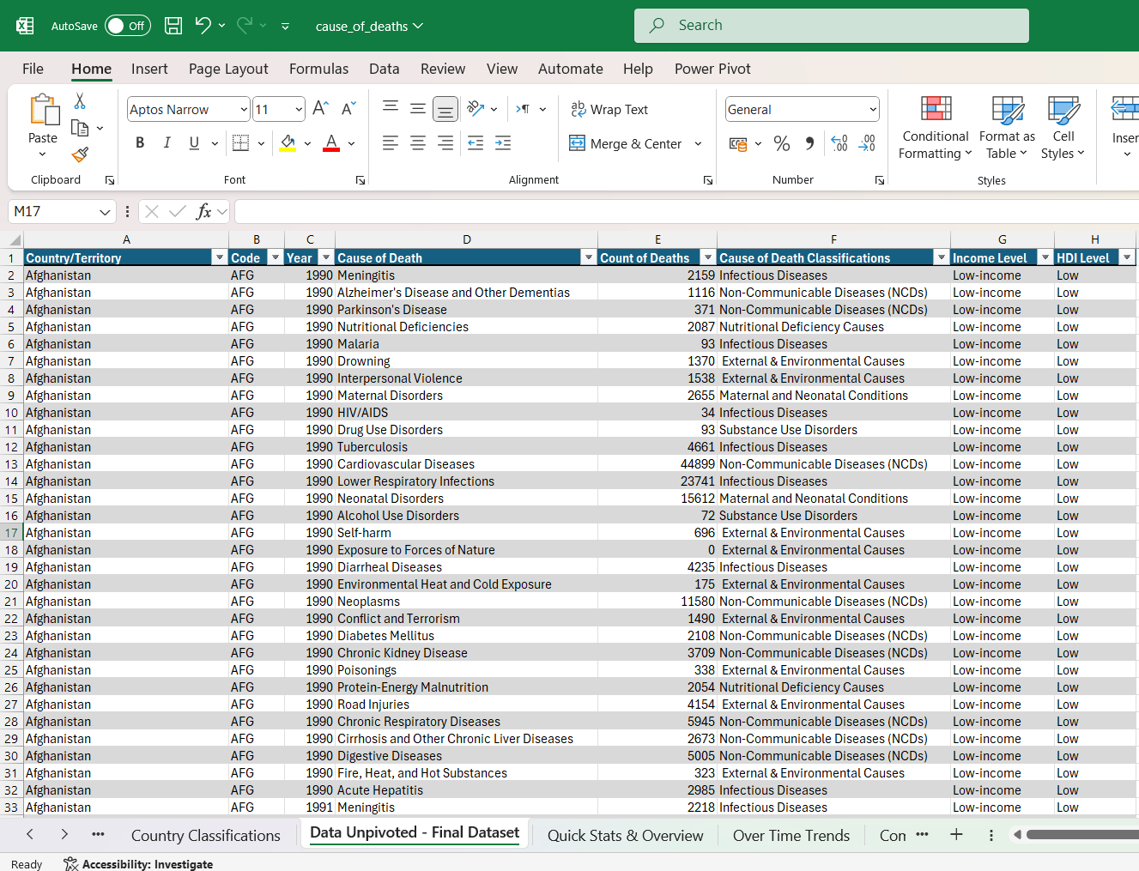
FINAL DATASET
After unpivoting the disease columns using Power Query and using Xlookup function to add the classifications to each corresponding row, the resulting dataset is in a tidy, consistent format and is ready for analysis and visualizations using pivot tables.

Slide 19
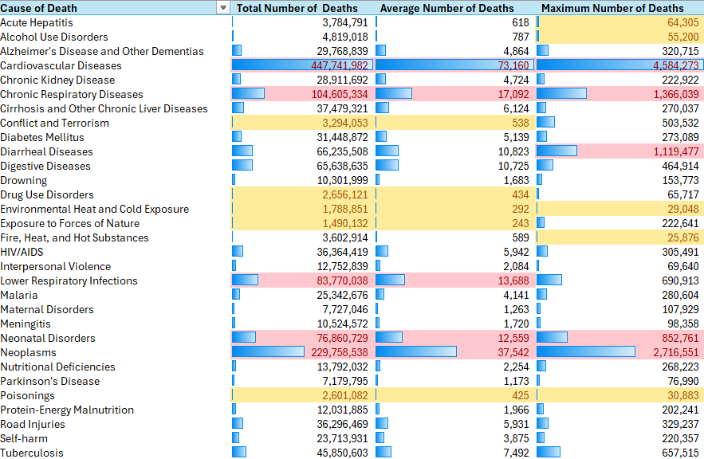
Using Excel pivot table and conditional formatting, the following insights can be derived:
- Leading Causes of Death:
Cardiovascular Diseases have the highest total number of deaths (447.7 million), followed by Neoplasms (cancers) (229.8 million) and Chronic Respiratory Diseases (104.6 million). These are significant global health concerns.
Other high-mortality causes include Lower Respiratory Infections (83.8 million) and Diarrheal Diseases (66.2 million).
- High-Impact Events:
Causes like Conflict and Terrorism and Exposure to Forces of Nature show relatively low total deaths (3.2 million and 1.5 million respectively), but their maximum death figures (503,532 and 222,641 respectively) indicate that extreme events or disasters account for a large portion of deaths at once.
QUICK STATS & OVERVIEW

Slide 20
QUICK STATS & OVERVIEW
- Low-Impact Events
Poisonings, Drug Use Disorders, and Environmental Heat and Cold Exposure show relatively smaller maximum deaths, which suggests that their impact is more spread out over time rather than being tied to singular, catastrophic events
- Consistent Killers:
Non-communicable diseases (Cardiovascular Diseases and Neoplasms) have very high average deaths per event (73,160 and 37,542 respectively), showing that they are widespread and consistently deadly. This reflects the global shift towards lifestyle-related conditions as the primary health burden.

Slide 21
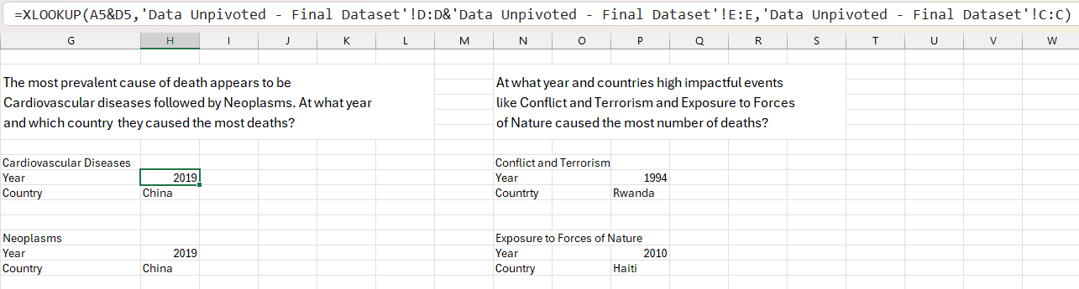
QUICK STATS & OVERVIEW
Using XLookup and Concatenation to highlight the years and countries at which the leading causes of death and impactful events caused the most number of deaths.

Slide 22
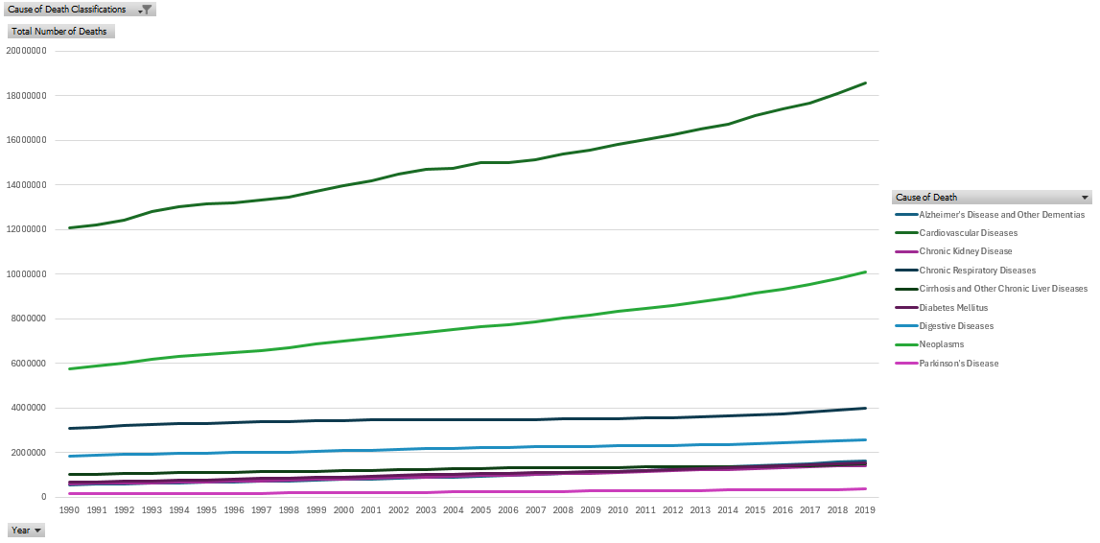
TRENDS OVER TIME
Overtime trend analysis focused on NCDS shows that:
The global burden of NCDs has substantially increased over the past three decades, with Cardiovascular Diseases remaining the leading cause of death and consistently accounting for the highest number of deaths throughout the period, more than all other NCDs combined.
Neoplasms were the second-leading cause of death after Cardiovascular Diseases, with deaths rising from 5.75 million in 1990 to 10.07 million in 2019.

Slide 23
TRENDS OVER TIME
The rise in Alzheimer's and related dementias deaths suggests growing public health challenges related to aging populations and lifestyle changes.
Diabetes-related deaths rose from 661,085 in 1990 to 1,549,593 in 2019, showing a steady but moderate increase, likely reflecting global lifestyle changes.
Deaths from cirrhosis and other chronic liver diseases also increased, but at a relatively slower pace compared to other diseases.

Slide 24
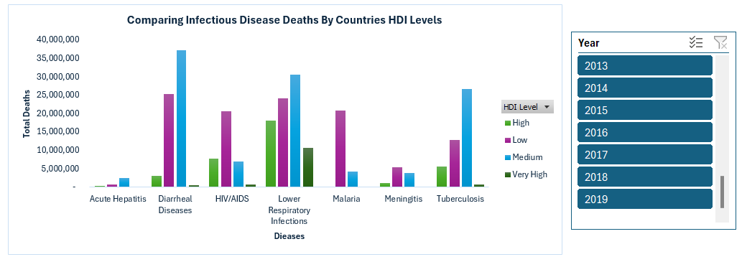
COMPARATIVE ANALYSIS
Comparing death counts of Infectious Diseases by HDI levels over time shows that:
- Diseases like HIV/AIDS, Diarrheal Diseases, and Malaria have significantly higher death counts in low and medium HDI regions.
- Lower Respiratory Infections affect both low and high HDI countries, though the burden is higher in less developed regions.
- Tuberculosis and Meningitis have a higher mortality rate in less developed countries.
- Malaria is nearly eradicated in very high HDI regions but remains a major cause of death in low HDI countries.
Which all indicate the weaker healthcare infrastructure in countries with lower HDI levels.

Slide 25
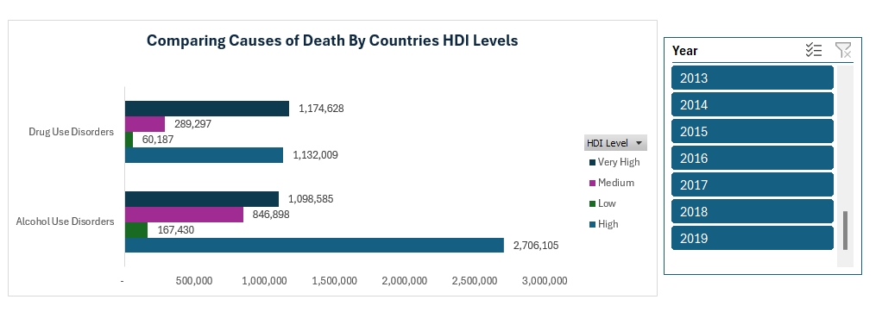
COMPARATIVE ANALYSIS
Comparing deaths by Alcohol and Drug Use Disorders by countries’ HDI levels overtime shows that they result in more deaths in high and very high HDI countries, reflecting lifestyle-related health issues.
The comparative analysis highlights the differing health challenges across development levels, with infectious diseases dominating in lower HDI countries and lifestyle-related issues prevalent in higher HDI countries.

Slide 26
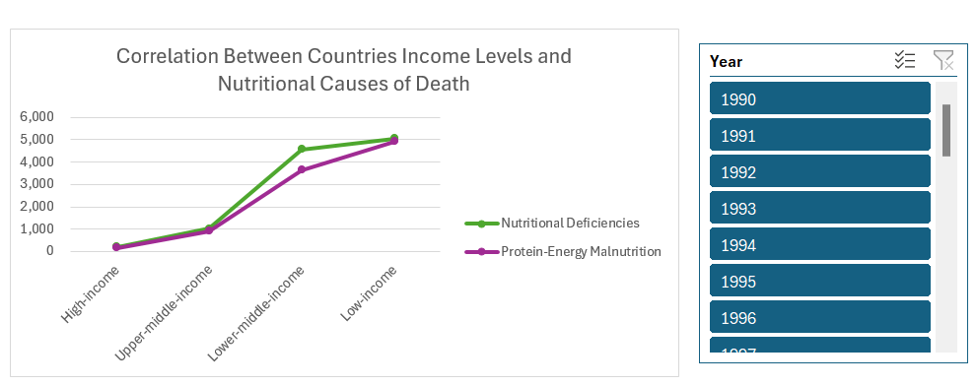
Correlation
Is there a correlation between countries income levels and the prevalence of nutritional deficiency causes of death?
Low and lower-middle income countries consistently had higher deaths due to nutritional deficiencies across each and all years.

Slide 27

POWER BI

Slide 28
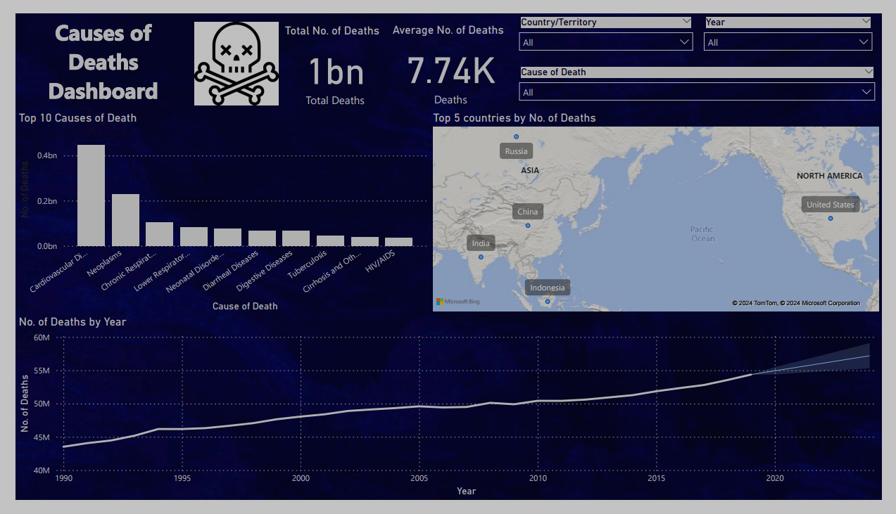
Power BI Dashboard

Slide 29
Power BI Dashboard
The visuals included in the dashboard are filtered by the country, year, and cause of death, using slicers.
A bar chart was created to visualise the top 10 causes of death.
The map chart demonstrates the top 5 countries based on the number of deaths.
The line chart shows the number of deaths through time and prediction for the following 5 years.

Slide 30
Final Recommendations
Governments should prioritize addressing the top 10 causes of death, with health ministries developing programs to raise public awareness about early disease detection and promoting safety measures to reduce mortality from these causes.
Governmental authorities must inform citizens if a pandemic exists or is suspected, or if there are any spreading diseases or fatal risks in the countries they are visiting or residing in. This can help limit the spread of disease and protect individuals from harm.

Slide 31
Final Recommendations
Continuous analysis of health data and causes of death can provide valuable, data-driven insights into mortality trends. This information can be used to predict the number of deaths and their causes, enabling authorities to take preventive actions, improve healthcare services, and respond more rapidly to save lives.
Establishing a global network to track common causes of death and share best practices could lead to better strategies for saving lives worldwide.

Slide 32
Thank You !

